Slide 1
Asia and the Future Economic Role of Japan
Remarks Prepared for the NBER Japan Project Meeting, 24-25 June 2011
Shinji Takagi
Graduate School of Economics
Osaka University

Slide 2
Main Argument
Growing Asia has been behind Japan’s changing trade structure; Asia is now Japan’s most important trading partner; as a counterpart, manufacturing employment within Japan has declined substantially
Increasing foreign income has kept Japan’s current account in surplus despite the considerable narrowing of the trade surplus; this represents returns on the balance of foreign (esp. portfolio) assets Japan has accumulated; but Asia is not a big part of this
There is thus asymmetry in Japan’s economic relationship with Asia between trade and finance

Slide 3
Main Argument (concluded)
(4) With continued population aging, net exports are expected to shrink (Japan may well begin to have a trade deficit in coming years); it is important to invest in Asia in order to earn higher returns—and also to retain influence in the region as the Japanese economy declines in relative importance
(5) Promoting financial integration within Asia should receive high priority; along with developing capital markets, there is a need to strengthen the existing vehicles of macroeconomic policy dialogue and cooperation
(6) The aim is to promote transparency in policymaking and to have a mechanism of dealing with spillovers; this will help create a stable region in which two-way financial (as well as trade) flows will flourish

Slide 4
Outline
Japan and the World—a broad national picture
Japan and Asia—asymmetry in trade and finance
Promoting financial integration in Asia—strengthening the existing vehicles of regional cooperation

Slide 5
1. Japan and the World

Slide 6
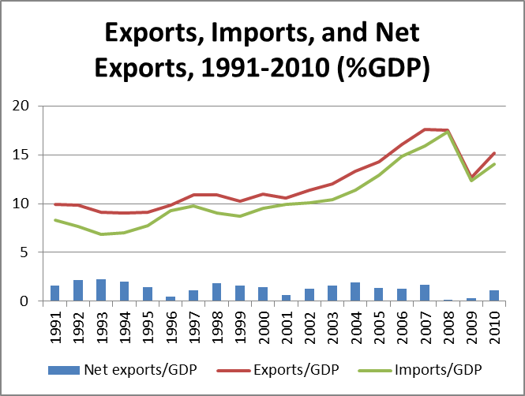
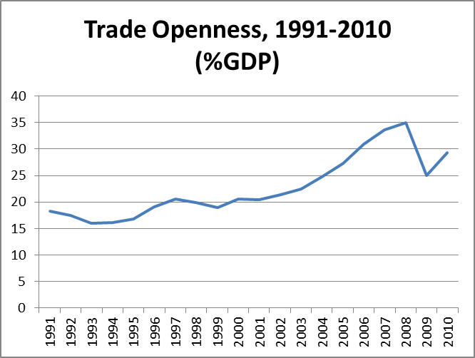
Japan’s External Sector Expanded during the Past 20 Years

Slide 7
This Corresponds to a Decline in Manufacturing Employment

Slide 8
Net Income from Abroad Increased during the Same Period

Slide 9
This Reflects the Accumulation of Net Foreign Assets

Slide 10
This Kept the Current Account in Surplus Despite the Narrowing of Trade Balance Surplus

Slide 11
Returns on Portfolio Investment Are by Far the Dominant Part of Foreign Income

Slide 12
2. Japan and Asia

Slide 13
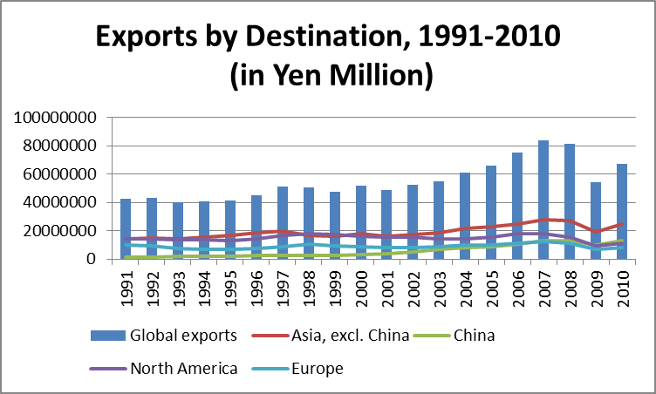
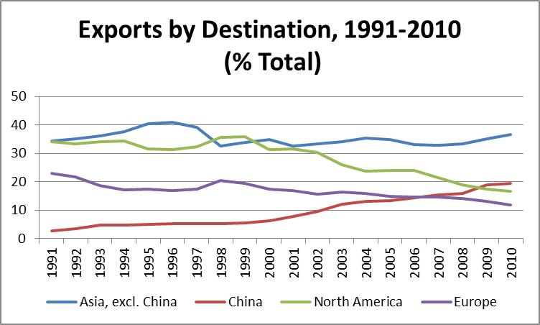
Asia is Japan’s Most Important Export Market; China’s Importance Rose

Slide 14
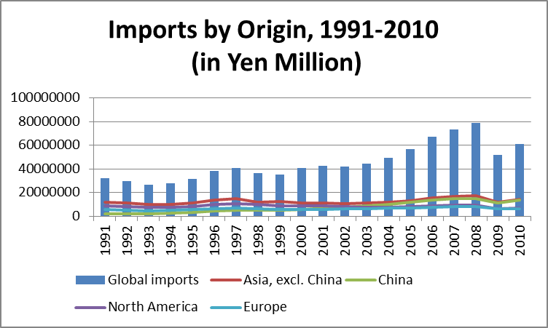
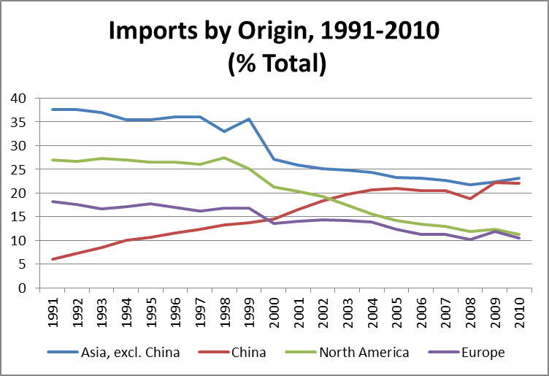
For Imports, Asia is Also the Most Important Origin; China’s Share Rose at the Expense of All Others

Slide 15
Trade Balance Surplus Narrowed with N. America and Europe, but Widened with Asia; A Deficit with China

Slide 16
But the Current Account Surplus with N. America and Europe Has Not Narrowed As Much

Slide 17
This Reflects a Larger Income Account Surplus with N. America and Europe

Slide 18
Japan’s Financial Link with Asia is Weak
Balance of External Assets and Liabilities at the end of 2009
(yen 100 million; percent of global total)
 | FDI |  | Equities |  | Medium to long-term bonds
 | Assets | Liabilities | Assets | Liabilities | Assets | Liabilities
 | 682097 | 184252 | 546870 | 763720 | 2073021 | 655244
Asia, excl. China | 16.29% | 8.57% | 5.97% | 1.68% | 5.97% | 1.68%
China | 7.43% | 0.10% | 2.12% | 0.01% | 2.12% | 0.01%
North America | 32.45% | 38.09% | 42.01% | 56.27% | 42.01% | 56.27%
Europe | 24.18% | 41.97% | 31.06% | 36.51% | 31.06% | 36.51%

Slide 19
3. Promoting Financial Integration in Asia

Slide 20
Why Is Japan’s Financial Link with Asia So Weak?
Asian capital markets lack depth, liquidity, and size; they are not as well developed
Quality of institutions (accounting rules, investor rights, etc.) is not up to par with North America or Europe
Country risk is high
There are few internationally known firms
Lack of transparency in policy making; there is not enough investment-relevant information
(in terms of capital inflows to Japan) Asia’s per capital income is still low
Many of these problems will go away as countries in the region continue to develop, but regional cooperation can also be a part of the solution

Slide 21
Macroeconomic and Financial Cooperation in Asia
Asia’s regional integration has been largely market-driven, with little role for institutions
Regional institutions are largely informal (no treaties) and fragmented
The most important among them is the ASEAN+3 mechanism (1997)
ASEAN+3 established (i) Chiang-Mai Initiative (CMI) of bilateral swap arrangements (2000); (ii) Economic Review and Policy Dialogue (ERPD)(2000); and (iii) Asian Bond Markets Initiative (ABMI) (2003)

Slide 22
CMI Multilateralization (CMIM)
A landmark agreement reached to multilateralize the CMI in 2007 (a “self-managed reserve pooling” arrangement under a single contractual agreement)
Total amount ($120) and shares agreed in 2009
Agreed in 2010 to set up the ASEAN+3 Macroeconomic Research Office (AMRO) in Singapore, to be staffed over 2010-12
In 2011, Wei Benhua, a Chinese, appointed to head the office (according to the press, to be replaced by Yoichi Nemoto, a Japanese, after a year)

Slide 23
Chiang-Mai Initiative Multilateralization
Members | Financial contributions |  | Purchasing multiple | Voting power (in percent of total)
 | Billions of US dollars | Percent of total
Plus Three Countries | 96.00 | 80.00 |  | 71.59
China | 38.40 | 32.00 |  | 28.41
PRC | 34.20 | 28.50 | 0.5 | 25.43
Hong Kong SAR | 4.20 | 3.50 | 2.5 | 2.98
Japan | 38.40 | 32.00 | 0.5 | 28.41
Republic of Korea | 19.20 | 16.00 | 1.0 | 14.77
ASEAN | 24.00 | 20.00 |  | 28.41
Brunei Darussalam | 0.030 | 0.025 | 5.0 | 1.158
Cambodia | 0.120 | 0.100 | 5.0 | 1.222
Indonesia | 4.552 | 3.793 | 2.5 | 4.369
Lao PDR | 0.030 | 0.025 | 5.0 | 1.158
Malaysia | 4.552 | 3.793 | 2.5 | 4.369
Myanmar | 0.060 | 0.050 | 5.0 | 1.179
Philippines | 4.552 | 3.793 | 2.5 | 4.369
Singapore | 4.552 | 3.793 | 2.5 | 4.369
Thailand | 4.552 | 3.793 | 2.5 | 4.369
Vietnam | 1.000 | 0.833 | 5.0 | 1.847
ASEAN+3 | 120.00 | 100.00 |  | 100.00

Slide 24
Problems
The amount is too small
Requirements of an IMF program for a drawing beyond 20%
AMRO politicized; independent surveillance doubtful
Weak and ill-defined TOR; the relationship between AMRO and ERPD not clear
Professional skepticism about the usefulness of cooperation or concern about duplication with the global architecture (IMF, G20, etc.)

Slide 25
The Way Forward
Increase the size (there is no cost under the current arrangement—but ideally CMIM should be allowed to manage its own resources to have greater independence)
At least initially, IMF financing should be linked, not to the amount, but to the length of a drawing (say, beyond 6months)—proposed by Chalongphob Sussangkarn, former Thai Finance Minister
AMRO should assume secretariat role of ERPD (evolve into an Asian Monetary Fund?)
Membership to be expanded to include Australia, India, New Zealand

Slide 26
Conclusion 1
Japan’s future depends on how it can benefit from being part of Asia
High priority should be given to strengthening its financial links with Asia, in order to earn high returns on the country’s foreign investments
Investing more of its portfolio assets in Asia is also a way of retaining Japan’s influence in the region as it importance declines in relative terms
Regional financial and macroeconomic cooperation is a way of creating a stable region in which more two-way financial (as well as trade) flows can flourish

Slide 27
Conclusion 2
ASEAN+3/CMIM/AMRO is imperfect but the best we’ve got; the existing mechanism is worth strengthening
The consequence will be just as political as economic, with economics being the only common language of the region
Regional economic cooperation is a way of containing China’s dominance through dialogue, and beneficial both to China and other countries

